Slide 1


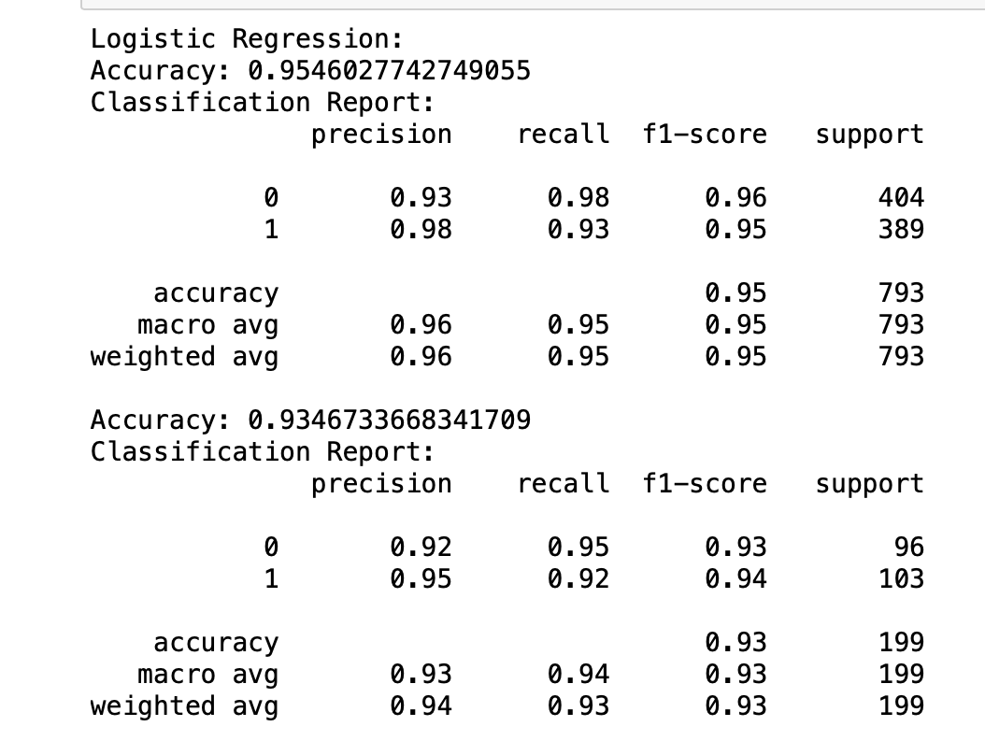

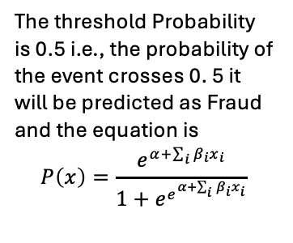
Credit Card Fraud Detection
Obs | Test | Pre
442 | 0 | 0
620 | 1 | 1
104 | 0 | 0
810 | 0 | 0
271 | 1 | 1
447 | 1 | 1
658 | 0 | 0
880 | 1 | 0
202 | 0 | 0
278 | 1 | 1
622 | 1 | 1
737 | 1 | 1
731 | 1 | 1
745 | 0 | 0
402 | 1 | 1
614 | 1 | 1
989 | 1 | 1
635 | 0 | 1
645 | 0 | 0
376 | 1 | 1
Problem Statement: To recognize (classify) fraudulent
credit card transactions and alert
customers so that they are not
charged for items that they did not
purchase.
Advantage
Output
Input Files
The threshold Probability is 0.5 i.e., the probability of the event crosses 0. 5 it will be predicted as Fraud and the equation is
$$P\left(x\right)=\frac{e^{α+\sum_{i}{β_{i}x_{i}}}}{1+e^{e^{α+\sum_{i}{β_{i}x_{i}}}}}$$
Methodology
Classification is a supervised machine learning method where the model tries to predict the correct label of a given input data.
In classification, the model is fully trained using the training data, and then it is evaluated on test data before being used to perform prediction on new unseen data
The Models used for classification are:
Logistic regression
Decision Tree
Random Forest
Support Vector Machine etc.,
ML
(Predictive Model)
Output Response
Output Response​

